Slide 1
Simulations OF TARGETS FOR NDCX II*
J. J. Barnard¹, J. Armijo², F. M. Bieniosek², A. Friedman¹, M. Hay², E. Henestroza², B.G. Logan², R. M. More², P. A. Ni², L. J. Perkins¹, S. F. Ng^{2,4}, S. A. Veitzer³, J. S. Wurtele², S. S. Yu^{2,4}, A. B. Zylstra²
1. Lawrence Livermore National Laboratory, Livermore, CA 94550, USA
2. Lawrence Berkeley, National Laboratory, Berkeley, CA 94720 USA
3. Tech-X Corporation, Boulder, CO 80303 USA
4. Chinese University, Hong Kong, China
Twelfth US-Japan Workshop on Heavy Ion Fusion and High Energy Density Physics
San Francisco, CA
September 6 – 11, 2009
*Work performed under the auspices of the U.S. Department of Energy under contract DE-AC52-07NA27344 at
LLNL, and University of California contract DE-AC02-05CH11231 at LBNL

Slide 2
NDCX II will serve as a platform for warm dense matter experiments and as a test bed for heavy ion fusion
1. Experimental concepts for Warm Dense Matter (WDM)
planar solid targets
metallic foams
c. cylindrical "bubbles"
d. spherical bubbles
2. Connecting simulations of WDM targets to diagnostics
a. simulating brightness temperature at critical density point
b. simulating velocity at critical density point
3. Simulations of experiments relevant to Heavy Ion Fusion (HIF)
a. coupling physics: two-pulse/ ramped pulse experiments

Slide 3
Complementary oral talks at IFSA cover other aspects of NDCX I and NDCX II
Oral 3.8.1 Frank Bieniosek, Wednesday, 9/9, 3:00 pm
ION-BEAM-DRIVEN WARM DENSE MATTER EXPERIMENTS
Oral 3.8.2 Alex Friedman, Wednesday, 9/9, 3:20 pm
PHYSICS DESIGN FOR NDCX-II, A SHORT-PULSE ION BEAM DRIVER FOR NEAR-TERM WDM AND TARGET PHYSICS STUDIES

Slide 4
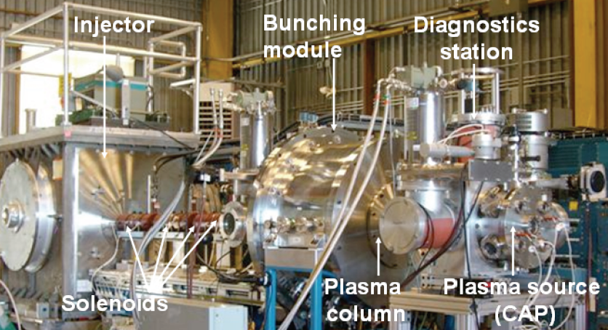
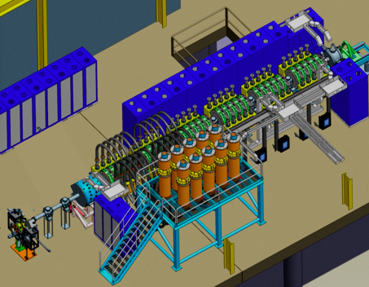
NDCX I is laying the groundwork for NDCX II
Explore metal liquid/vapor
boundaries at T ~ 0.4 eV
Evaporation rates/ bubble and droplet formation
Test beam compression physics
Test diagnostics
NDCX I
0.35 MeV,
0.003 μC
Now
Bragg peak (uniform) heating
T ~1-2 eV in planar metal targets
(higher in cylindrical/spherical
implosions)
Ion⁺/Ion⁻ plasmas
Critical point; complete liquid/
vapor boundary
Transport physics (e-cond. etc)
HIF coupling and beam physics
NDCX II
3 - 6 MeV,
0.03 μC
Completion
date:
2011

Slide 5
Several target options have been considered for WDM studies on NDCX II
>6 μ hole diameter
Ion beam
Ion beam
1 mm spot diameter
1 mm spot diameter
3.5 μ
Expected regime:
~1.2 eV, 0.2 Mbar
3.5 μ
Solid planar targets
Cylindrical "bubble" targets
1 μ bubble diameter
Foam densities ~ few % to solid
Ion beam
Ion beam
1 mm spot diameter
1 mm spot diameter
3.5 μ
35 μ
(for 10% foam)
Pore size
~ nm to ~ μm
Spherical bubble targets
Foam planar targets

Slide 6
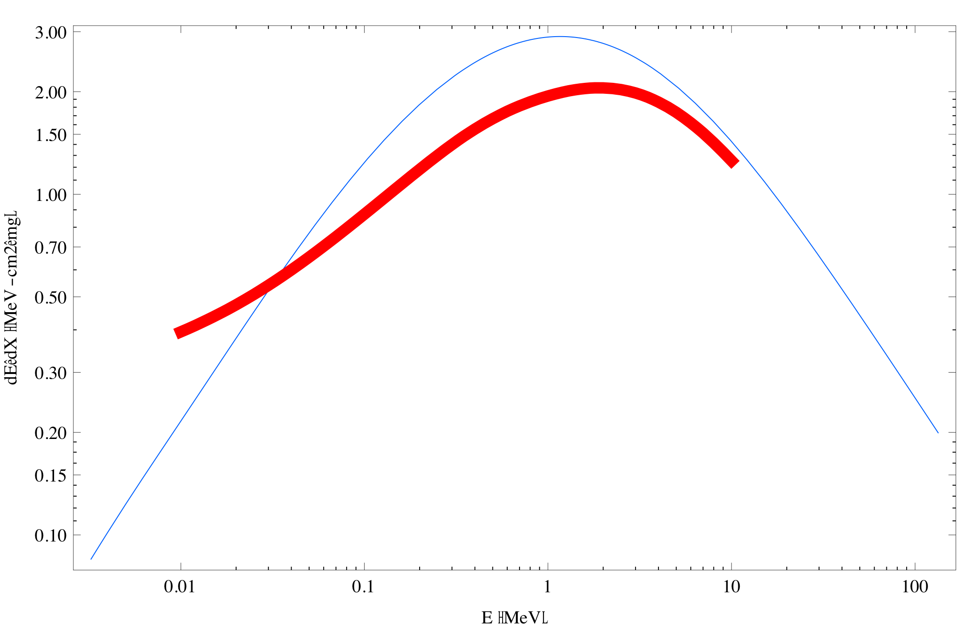
The nominal beam assumes a 30 J/cm² 2.8 MeV Li ion beam, corresponding to 20 kJ/g in Al (SRIM)
HYDRA/
QEOS
SRIM
Ion beam
1 mm spot diameter
3.5 μ
Expected regime:
~1.2 eV, 0.2 Mbar
Solid planar targets
For HYDRA¹ runs we assume the nominal beam results in 20 kJ/g in Al.
This implies the simulated beam had a fluence of 20 J/cm² (instead of 30 J/cm²)
1. M. M. Marinak, G. D. Kerbel, N. A. Gentile, O. Jones, D. Munro, S. Pollaine, T. R. Dittrich, and S. W. Haan, Phys. Plasmas 8, 2275 (2001).

Slide 7
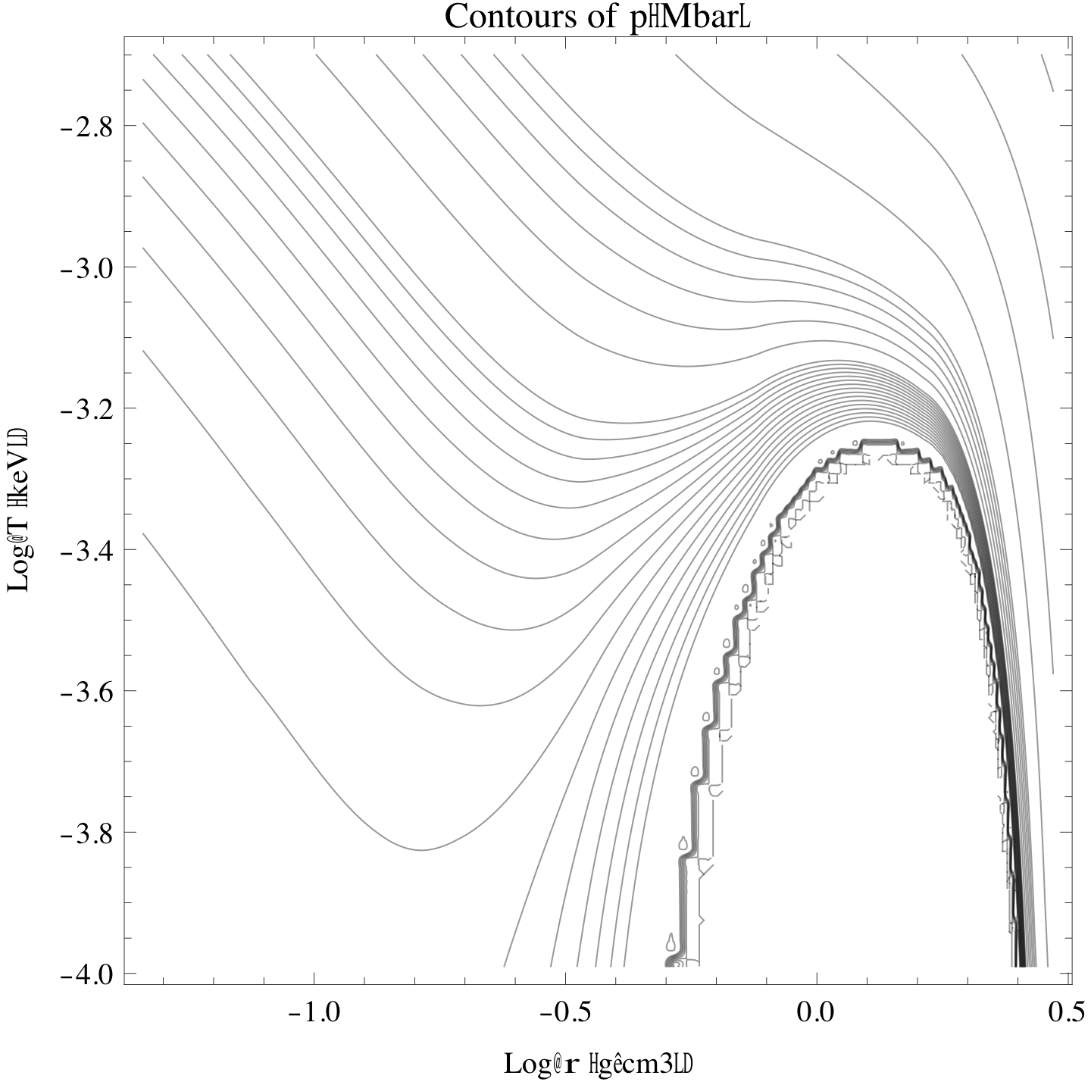
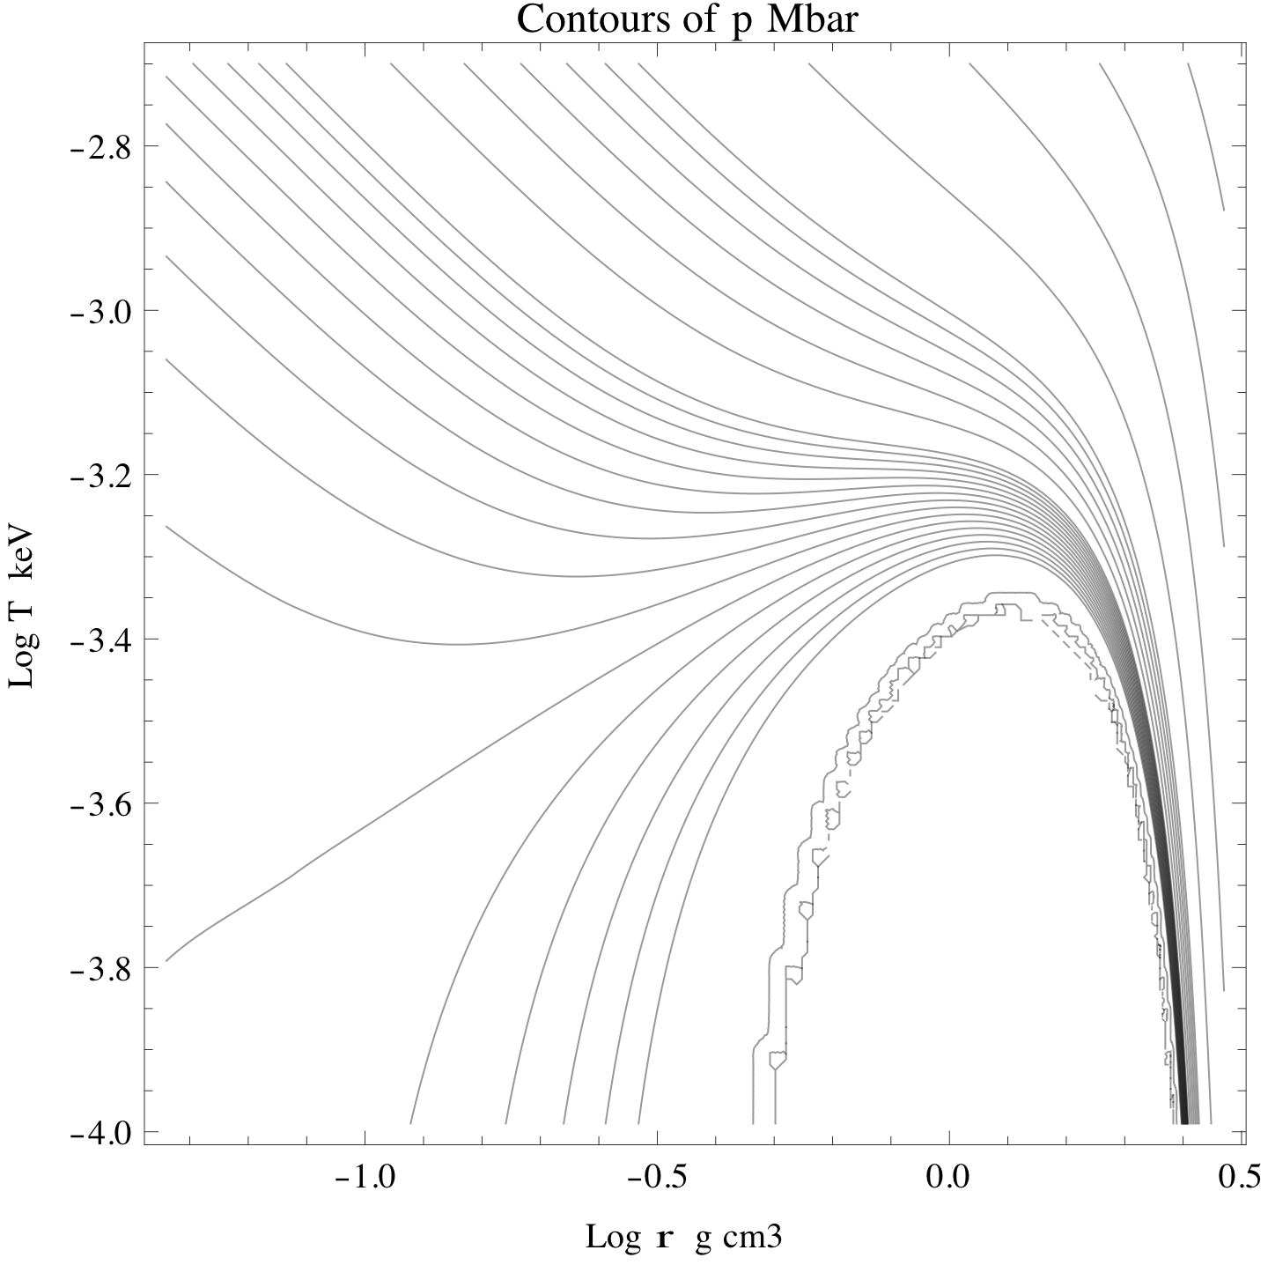
An example of two significantly different EOS
QEOS
Aluminum
LEOS
0.32
0.04
0.32
0.04
0.01
0.01
+
+
0.001
Log[T (keV)]
Log[T (keV)]
0.001
0.0
-0.001
-0.001
0.0
Log[ρ (g/cm³)]
Log[ρ (g/cm³)]
Log[ρ (g/cm³)]
Critical point:
Critical point:
p=0.029 MBar
ρ=0.78 g/cm³
T=0.945 eV
Theories and experiments place critical point between 5500 K and 12000 K (0.5 eV and 1.0 eV)
p=0.0065 MBar
ρ=0.70 g/cm³
T=0.633 eV

Slide 8
Evolution of center of 3.5 μ thick Al foil over the heating phase (1 ns) using QEOS without maxwell construction
density
temperature
pressure
Z*

Slide 9
Evolution of center of 3.5 μ thick Al foil over the heating phase (1 ns) using QEOS without maxwell construction
v_{z}
entropy
QEOS CP
T
LEOS CP
ρ

Slide 10
Target evolution was tracked for 30 ns
Temperature
v_{z}
Entropy
T
ρ

Slide 11
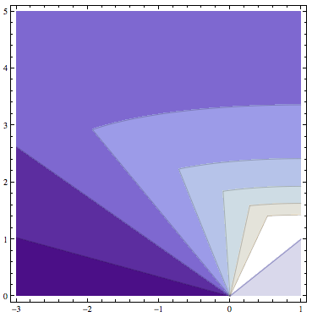
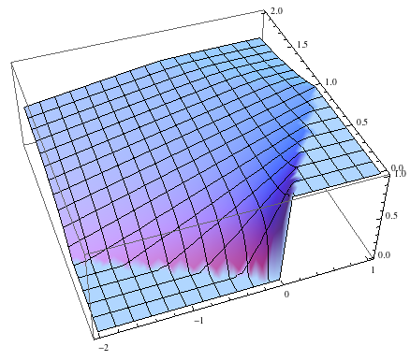
Critical frequency ν_{crit} defines "over dense" point where wave propagation becomes evanescent
Consider idealized case: Energy instantaneously deposited; ideal gas; Z* = constant
Density contours
c_{s}t/L
c_{s}t/L
density
z/L
z/L
For adiabatic evolution lines of constant density coincide with lines of
constant temperature (since T ~ ρ^{γ-1} ).

Slide 12
As estimate of brightness temperature T_{b} at a given ν we may take the black body intensity at the temperature of the critical point
Density contours
T_{b}
c_{s}t/L
c_{s}t/L
z/L
- Brightness temperature will stay constant until contour reaches z axis
- Brightness temperature will stay constant for longer times at lower frequencies

Slide 13
For the actual target case (QEOS shown here) we may plot hν_{crit} vs z and T(hν_{crit}) vs t for several hν_{crit}'s
Model assumes:
T_{b} = T(hν_{crit}) if hν_{critmin} < hν < hν_{critmax}
T_{b} = Tmax if hν > hν_{critmax}
T_{b} = 0 if hν < hν_{critmin}
hν_{crit}
T_{max}
z (microns)
150 nm (8.3 eV) (UV)
450 nm (2.4 eV) (Green visible)
1500 nm (0.83 eV) (IR)

Slide 14
We may compare the same plots for different intensities
Upper set: 20 kJ/gm
Middle set: 15 kJ/gm
Lower set: 10 kJ/g
(Magenta curves: T_{max}; Blue curves: 150 nm
Green curves: 450 nm; Red curves: 1500 nm)
(UV most sensitive to change in deposited energy;
IR (which samples cooler part of blowoff, less sensitive)

Slide 15
We may also compare two equations of state
Upper set: LEOS without Maxwell construction
Lower set: QEOS without Maxwell construction
(Magenta curves: T_{max}; Blue curves: 150 nm
Green curves: 450 nm; Red curves: 1500 nm)
Now IR is most sensitive to the EOS, and the two
EOS should be distinguishable

Slide 16
We may also compare the same equation of state with or without the Maxwell construction
Upper set: LEOS with Maxwell construction
Lower set: LEOS without Maxwell construction
(Magenta: T_{max}; Blue: 150 nm
Green: 450 nm; Red: 1500 nm)
Now IR is VERY sensitive to the choice of
Maxwell construction or no Maxwell construction

Slide 17
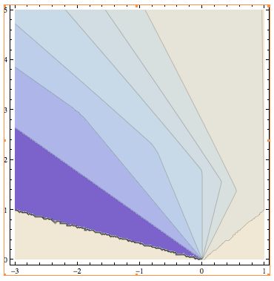
We may also calculate the velocity at the critical density for a particular photon frequency as a function of time
Again looking at the idealized case (instantaneous heating, ideal gas,
constant Z*):
Velocity contours
Density contours
The velocity contours
first align with, then
cross the density
and temperature
contours, so the
velocity measured
at the critical density
would first be
constant then plummet
c_{s}t/L
c_{s}t/L
z/L
z/L
v_{critical_dens}/c_{s}
T_{critical_dens}
Time at which
density contour
reaches z=0 axis
c_{s}t/L
c_{s}t/L

Slide 18
For realistic equations of state and finite heating time the velocity would also reach zero at the end of the flattop in T_{b}
(Magenta: Velocity of outermost zone; Blue: 150 nm
Green: 450 nm; Red: 1500 nm)
Upper set: LEOS with Maxwell construction
Lower set: QEOS without Maxwell construction
Again, the IR is best suited for distinguishing different EOS

Slide 19
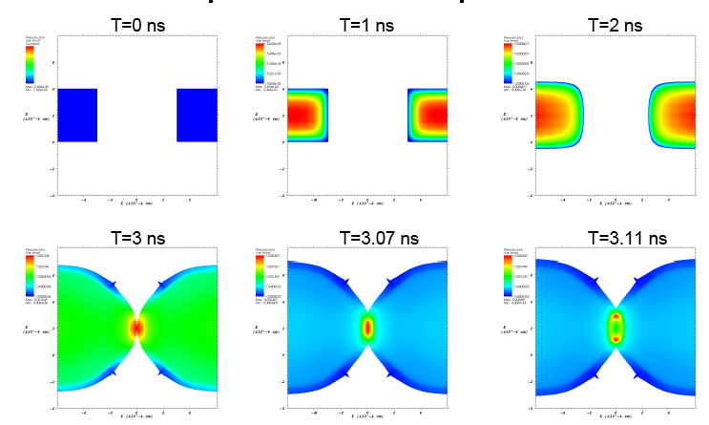
A cylindrical hole can create regions of temperature and pressure larger than in a simple foil
eV
eV
T
.056
T
.67
T
.051
.51
4μ
6μ
Ion beam
eV
eV
eV
1.2
T
2.4
T
2.5
T
.42
.42
.90
HYDRA simulations by E. Henestroza (using LEOS).
Solid Tin target. 2.8 MeV Li⁺, 10 J/cm² assumed.
T_{max} = 2.6 eV; P_{max} = 1.3 Mbar ρ_{max}= 11 g/cm³ (ρ_{init}= 7 g/cm³ ); v_{imp} = 3.5 km/s
Advantage: relatively easy to manufacture and diagnose

Slide 20
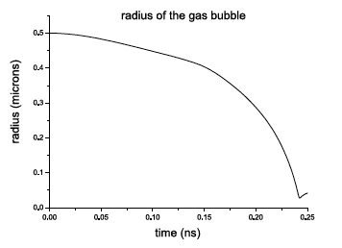
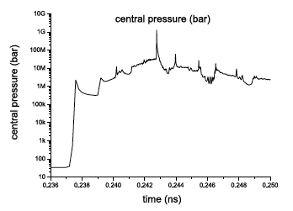
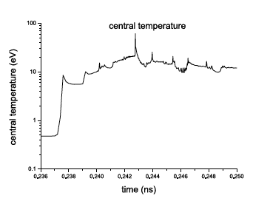
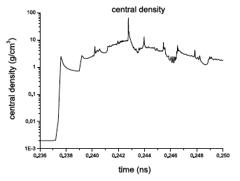
If instead of a cylindrical hole, a spherical void is placed in the foil, higher pressures are possible
1 μ bubble diameter
Simulation:
0.5
0.5 μ
Ion
beam
radius (μm)
1.75 μ
3.5 μ
Deposition:
25 kJ/g/ns for 1 ns
Simulations by Siu-Fai Ng
(using DISHr, QEOS)
P_{max} > 10 Mbar, T_{max} > 10 eV, ρ_{max} > 5 g/cm³
0
t (ns)
0.250
10M
10
5
Central Temp (eV)
Central density (gcm⁻³)
Central Pressure (bar)
0.236
0.250
0.236
0.250
t (ns)
t (ns)
0.236
t (ns)
0.250

Slide 21
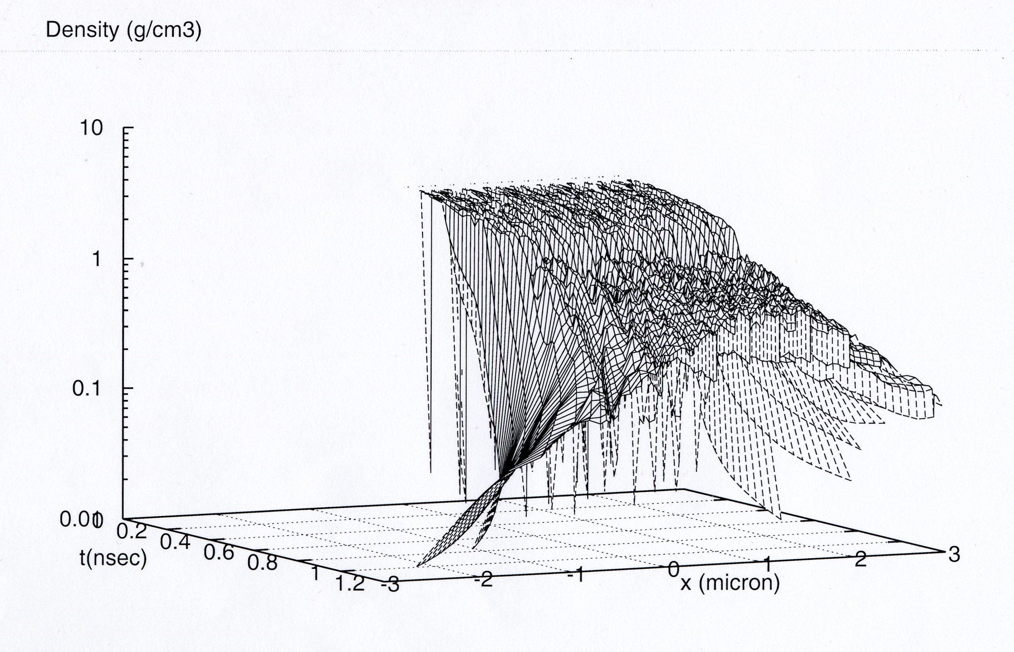
Foams have been modeled as layers of solid separated by layers of void
Codes used on foam modeling include: DPC (Saha based EOS), HYDRA (using QEOS), and DISH (using van der Waals EOS)
Foams of interest because:
Intrinsic physics
Radiator for HIF
Structural material in ICF
15 layers
Evaporate
Homogenize
Expansion/
release

Slide 22
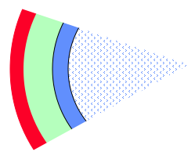
NDCX II will also study ion beam coupling physics that is key to creating high gain direct drive targets for Inertial Fusion Energy
Ion beam initially heats ablator
Ion beam
Ablator
Fuel
Initial ion range
Direct drive capsule
Later in time:
v ~ c_{s}
Fuel
Blow-off plasma
Ablation front would separate from
location where energy is deposited
==> Potential low coupling efficiency
Ablation front
Unique features of heavy ion direct drive can maximize drive efficiency:
1. Passive approach: Ion beam heating causes electron thermal speed to go above ion velocity ==> range lengthens, and ion beam can stay close to ablation front, (if ion energy is sufficiently low)
2. Active approach: Ramping ion beam energy over the course of the pulse, will also increase range.

Slide 23
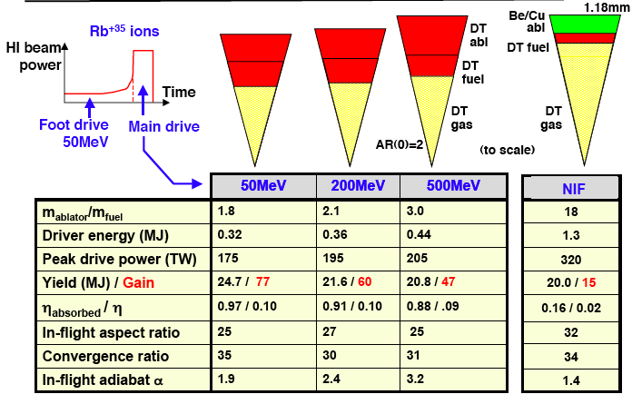
Recent heavy ion capsule designs by Perkins show NIF target yields at 1/4 to 1/3 the driver energy of NIF
(from J. Perkins et al, Hirschegg Presentation, 2009).

Slide 24
Conclusions
NDCX II is being designed for both Warm Dense Matter (WDM) and Heavy Ion Fusion (HIF) applications
For WDM, several target geometries lead to warm dense matter conditions
- planar targets at ~ 1 eV, .5 MBar are predicted;
- cylindrical imploding bubbles will reach a few eV, 1 MBar
- spherical imploding bubbles can reach ~10 eV, 10 Mbar
Foam dynamics are of interest for both WDM and HIF applications.
NDCX II pyrometry experiments should relatively easily be able to distinguish between specific equations of state (for example, QEOS and LEOS). VISAR experiments may also be able to distinguish different EOS.
For HIF, we are exploring direct drive concepts that have high coupling efficiency, by utilizing temperature dependent range and ramped ion energy. NDCX II will be able to test key aspect of direct drive target concept: changing ion energy to keep ion deposition point close to ablation front. Beam physics such as wobbler, and beaming bending can be tested.

Slide 26
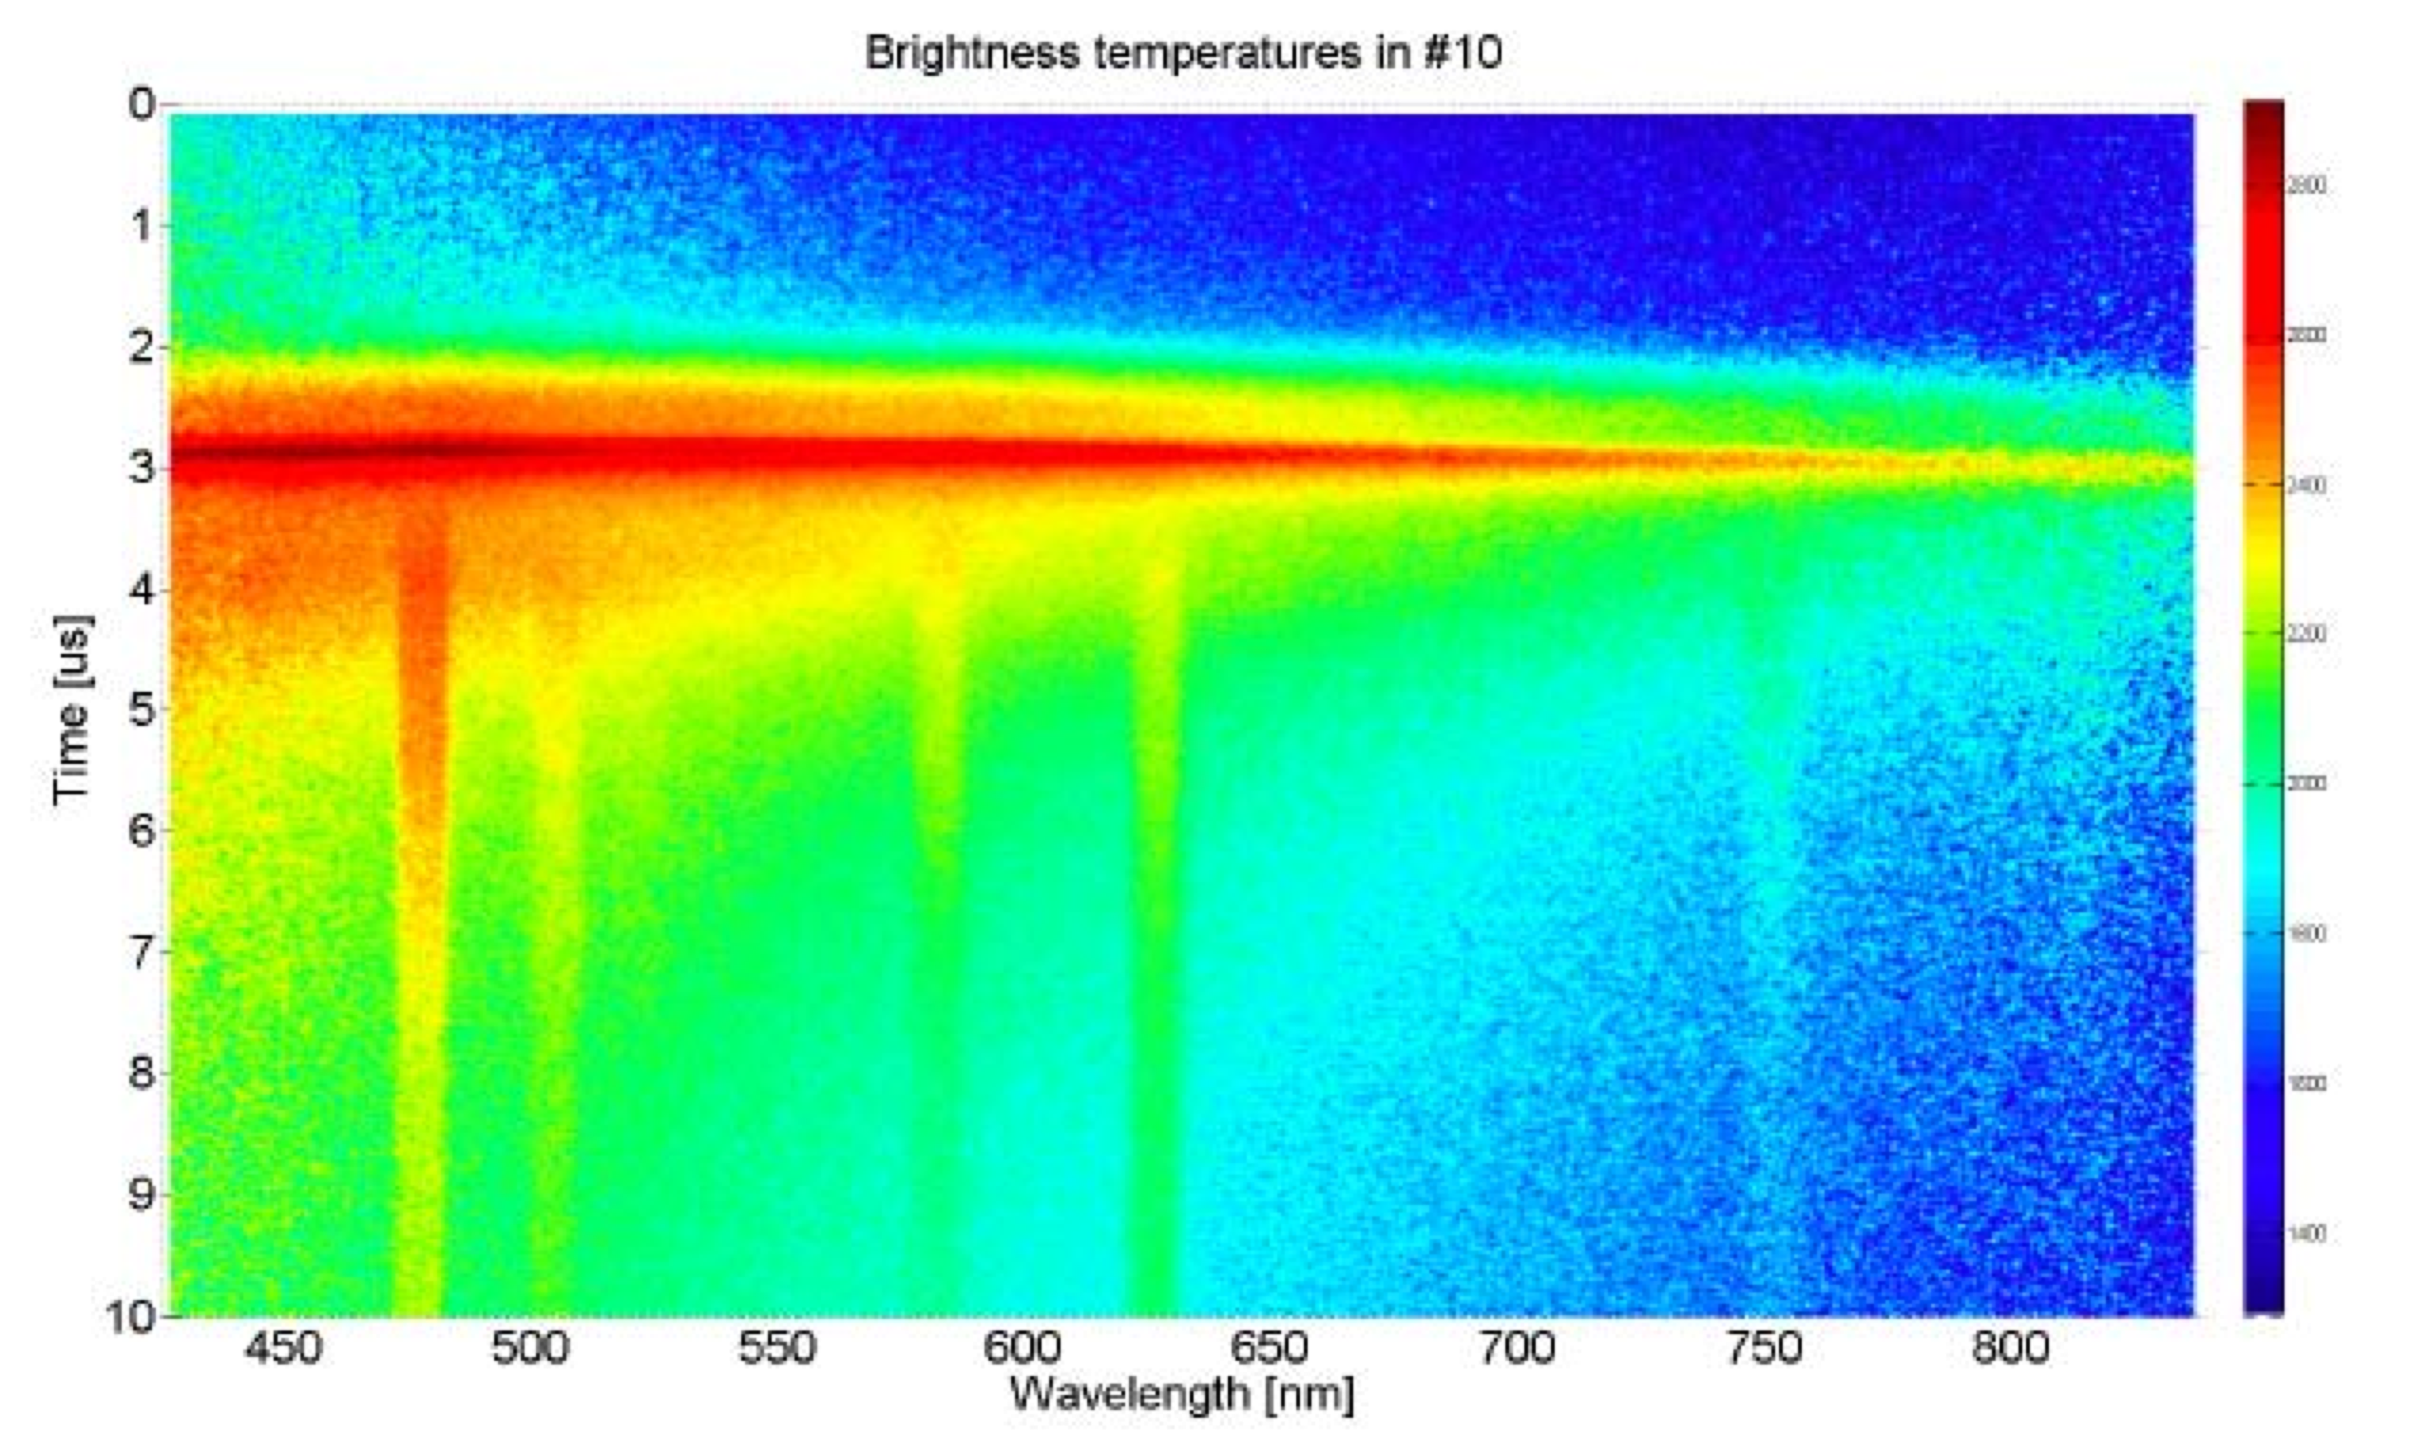
Typical data in foil targets shows heating from the prepulse and compressed pulse on NDCX I
Streak-spectrometer data in Au target showing transition from continuum emission to emission lines from heated gold

Slide 27
Abstract
The Neutralized Drift Compression Experiment II (NDCX II) is an induction accelerator now planned for completion in 2011. The baseline design calls for a 3 MeV, 30 A Li⁺ ion beam, delivered in a bunch with characteristic pulse duration of 1 ns, and transverse dimension of order 1 mm. The purpose of NDCX II is to carry out experimental studies of material in the warm dense matter regime, and ion beam/hydrodynamic coupling experiments relevant to heavy ion based inertial fusion energy. In preparation for this new machine, we have carried out hydrodynamic simulations of ion-beam-heated, metallic targets, connecting observable quantities with the simulated density, temperature, and velocity. Simulated target geometries include spherical and cylindrical bubbles (to create enhanced regions of higher pressure and temperature), in addition to planar solid and planar foam targets. Pulse formats include single pulses of fixed ion energy, and double pulses with varied energy (or single pulses with ion energy that changes over the pulse) to investigate ion coupling efficiency, motivated by simulations of ion driven direct drive capsules that have shown high coupling efficiencies at low total pulse energy (< 1 MJ).

Slide 28
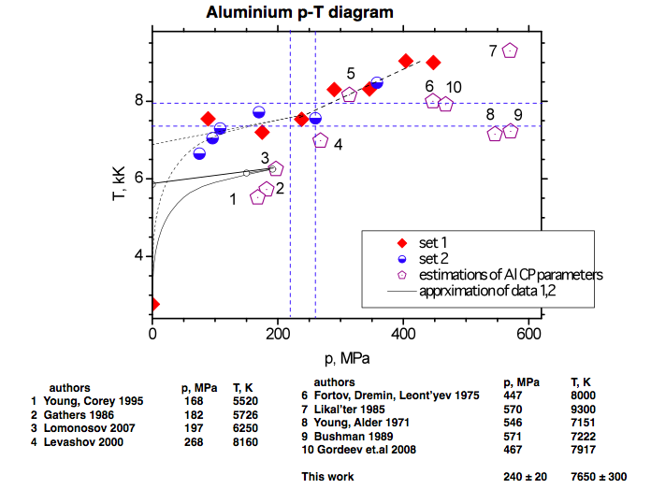
Theories and experiments place critical point between 5500 K and 11000 K (0.47 eV and 0.945 eV)
From
presentation
by
Dmitry
Nikolaev
July 6, 2009,
LBNL

Slide 29
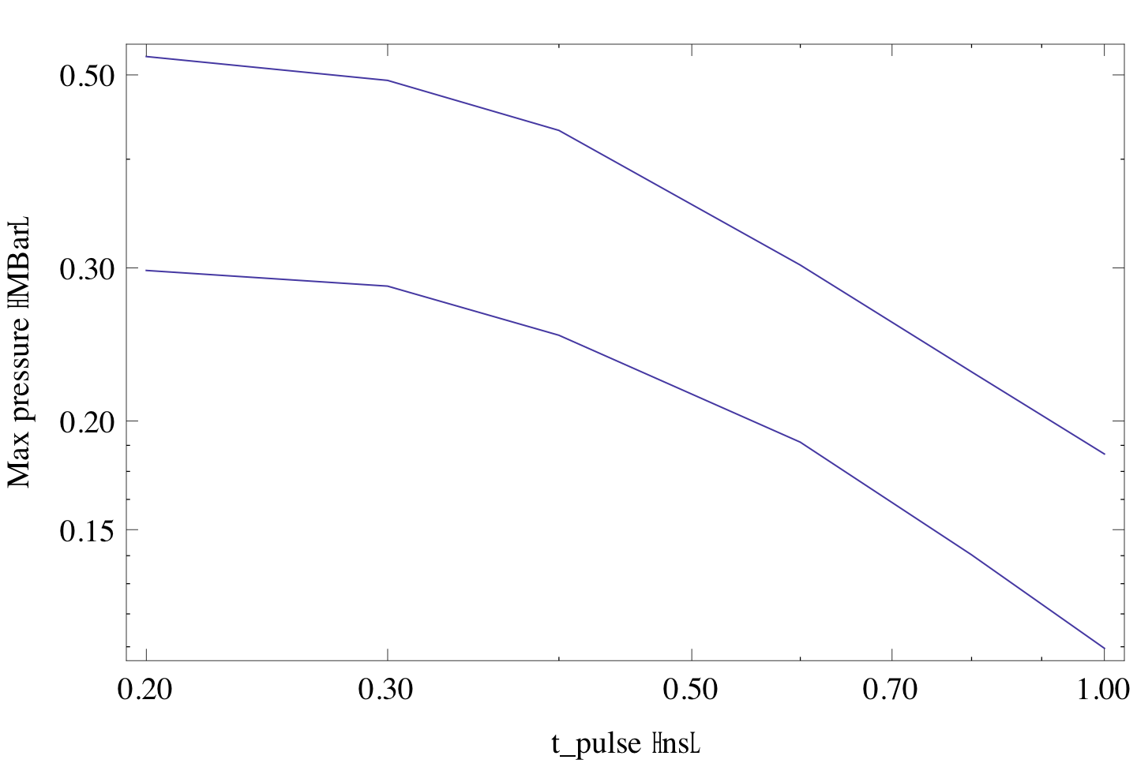
Is NDCX II near an optimum in tradeoff between pulse energy vs. pulse duration?
One figure of merit is central pressure in the foil, since it reflects both
high density and high temperature
Maximum central pressure
20 kJ/g (30 J/cm²)
10 kJ/g (15 J/cm²)
Design point
Example: If the pulse duration is reduced to 0.62 ns and the pulse energy reduced to 10 kJ/g, the same central pressure is reached.

Slide 30
Outline
We present HYDRA simulations of solid foil targets using a beam with NDCX II parameters
Questions addressed:
1. Can we reach the critical point in metals such as Al with NDCX II?
2. Can we use pyrometry or VISAR measurements to distinguish between equations of state?
3. Are we at the optimum combination of pulse duration and total pulse
energy?

Slide 31
Heavy-ion direct drive LASNEX runs by John Perkins found gains ≥ 50 at 1MJ with high coupling efficiency (15%).
Coupling efficiency ≡ fuel shell kinetic energy/ion beam energy
3μm solid CH shell
Heavy-ion direct drive (1MJ) 50 MeV Argon
2.00mm
Ablator
All DT ablator
Drive efficiency (%)
~250TW
1 .9mm
DT fuel
HI beam power
DT/CH ablator
1.0MJ
DT gas
0
Time (ns)
~14
Ablator rho-R (g cm-2)
(See Logan, Perkins, Barnard, Phys. of Plasmas, 15, 07271, 2008).
Higher efficiencies and gains may be possible by using energy ramp
Coupling efficiency Target gain (at 1MJ drive)
Laser Indirect Drive ~ 2-4% ~ 10
Laser Direct Drive ~ 5-8% ~ 25
Heavy ion direct drive with energy ramp ~ 25% ~ 100

Slide 32
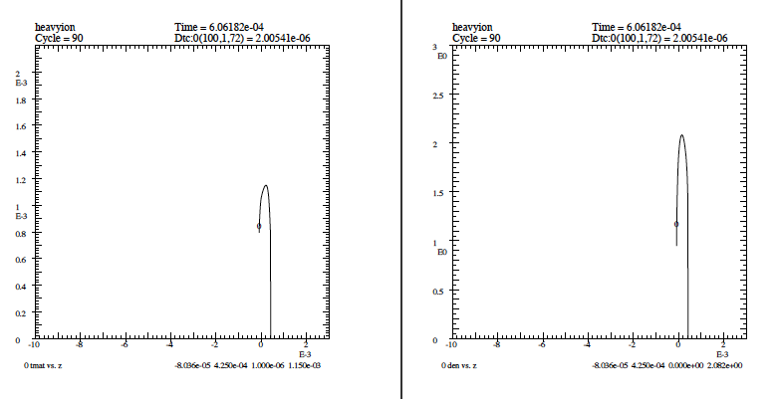
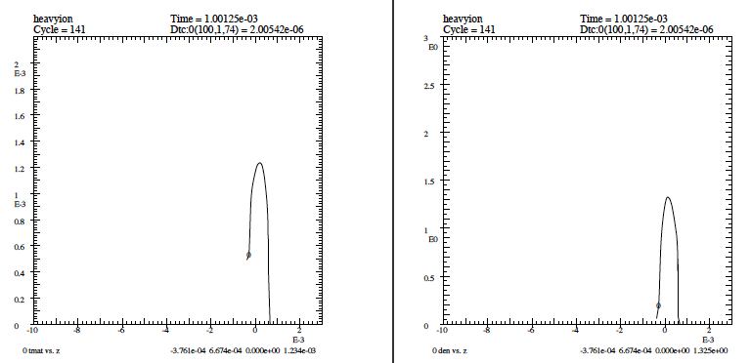
At 30 J/cm² (20 kJ/g), (Al) target center reaches 1.1 eV, density 2.1 g/cc at 0.6 ns.
T
Density
0.6 ns
T
Density
1.0 ns

Slide 33
Evolution of center of 3.5 μ thick Al foil over the heating phase (1 ns) using LEOS with maxwell construction

Slide 34
Evolution of center of 3.5 μ thick Al foil over the heating phase (1 ns) using LEOS with maxwell construction

Slide 35
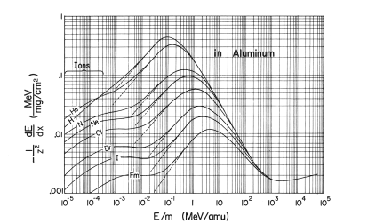
NDCX II will nominally operate at the Bragg peak using Lithium ions for WDM experiments
Energy
loss rate
Li @ 0.4 MeV/amu = NDCX II (planned )
(Bragg peak)
K @ 0.009 MeV/amu = NDCX I
(nuclear stopping plateau)
(MeV/mg cm²)
(dEdX figure from L.C Northcliffe
and R.F.Schilling, Nuclear Data Tables,
A7, 233 (1970))
Energy/Ion mass
(MeV/amu)
uniformity and fractional energy loss can be high if operate at Bragg peak (Larry Grisham, PPPL)
Ion beam
Exit foil
at energy
~0.5 x E_{peak}
Enter foil
at energy
~1.5 x E_{peak}

Slide 36
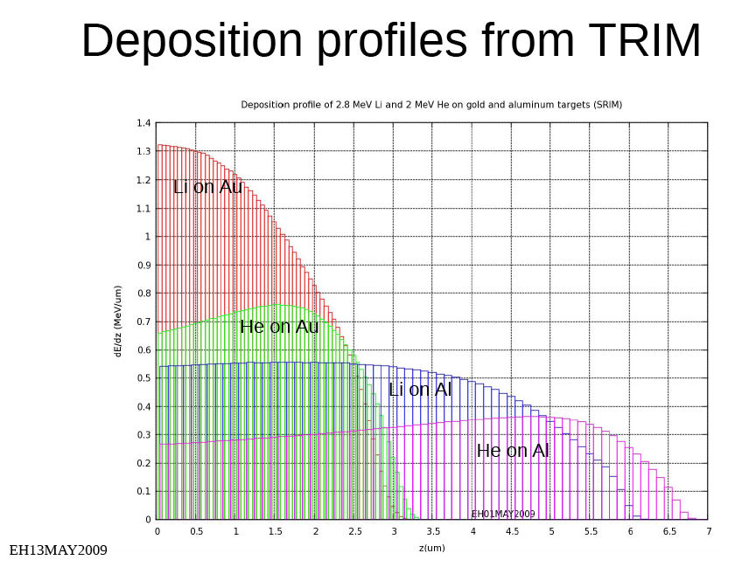
From Enrique Henestroza's NDCXII talk May13, 2009

Slide 37
The nominal beam assumes a 30 J/cm² 2.8 MeV Li ion beam, corresponding to 20 kJ/g in Al (SRIM)
HYDRA/
QEOS
SRIM
For HYDRA runs we assume the nominal beam results in 20 kJ/g in Al.
This implies the simulated beam had a fluence of 20 J/cm² (instead of 30 J/cm²)

Slide 40
Simulations show that an NDCX II double pulse experiment could confirm benefits of double pulsing
9 mm
(1 ns)
Ion beam
1 mm
50 μ
Ion: Li⁺ or Li⁺⁺
Target: Solid Ar
Intensity: 30 J/cm2
(each pulse)
Each pulse: 1 ns long
2nd pulse, 1ns after 1st
Simulations by Siu Fai Ng
(DISH; vdw EOS)
(simulations by Vietzer indicate room temp Al foam also candidate)

Slide 41
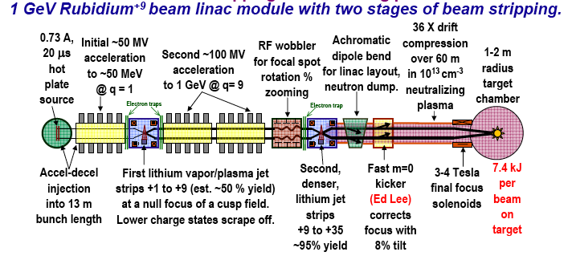
In addition to target physics, NDCX II will serve as a platform for driver beam physics tests
- RF Wobbler dynamics
- beam bending
- beam-plasma interactions
- unneutralized acceleration with
bunch compression
- neutralized bunch compression
and final focus
Example of one module of driver:

Slide 42
We are proposing an ER LDRD that is relevant to Direct Drive coupling physics and NDCX II
Heavy Ion Beam Approach to Inertial Fusion-Fission Hybrids
(This LDRD proposal is one of two simultaneous, coordinated proposals being submitted at LLNL and LBNL)
LLNL: John Barnard (PI), Alex Friedman, Wayne Meier, L. John Perkins, Ralph Moir, Michael Hay (UC Berkeley undergraduate)
LBNL: Bernhard Ludewigt, Robert Budnitz, B. Grant Logan, Roger Bangerter, Andy Sessler, Per Peterson (UC Berkeley)
LLNL Funding Request: FY10=375k$, FY11=375k$, FY12=375k$
LBNL Funding Request: FY10=290k$, FY11=290k$, FY12=290k$
What do the unique properties of ion beam acceleration, final focus, and ion deposition imply about ion-based fusion-fission hybrid concepts?
Can low pulse energy (< ~0.5 MJ) heavy-ion-based direct drive targets be used for small entry-level hybrid (or inertial fusion energy) drivers?
Can a thick liquid or wetted wall be used in a hybrid?
What are the systematic tradeoffs between ion energy, ion mass, pulse energy, and target gain in hybrid systems?

Slide 43
Extras

Slide 44
We have identified a series of warm dense matter experiments that can begin on NDCX-I at Temperature < 1 eV
 | Target temp. | NDCX-1 | NDCX-2
Metallic foam experiments at GSI | ~0.5 eV
Measure target temperature using a beam compressed both radially and longitudinally | Low | √
Thin target dE/dx, energy distribution, charge state, and scattering in a heated target | Low | √
Positive - negative halogen ion plasma experiment | >0.4 eV | √ | √
Two-phase liquid-vapor metal experiments | 0.5-1.0 | √ | √
Critical point measurements | >1.0 | ? | √
Ion deposition and coupling experiments | >1.0 |  | √
Collapsing bubble experiments | >1.0 |  | √
time

Slide 45
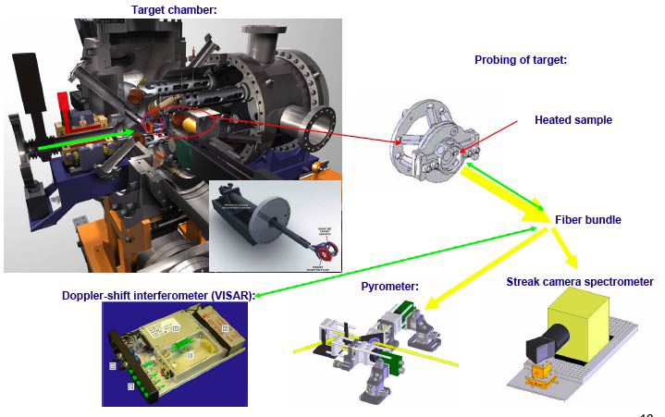
NDCX I now uses a suite of optical diagnostics

Slide 46
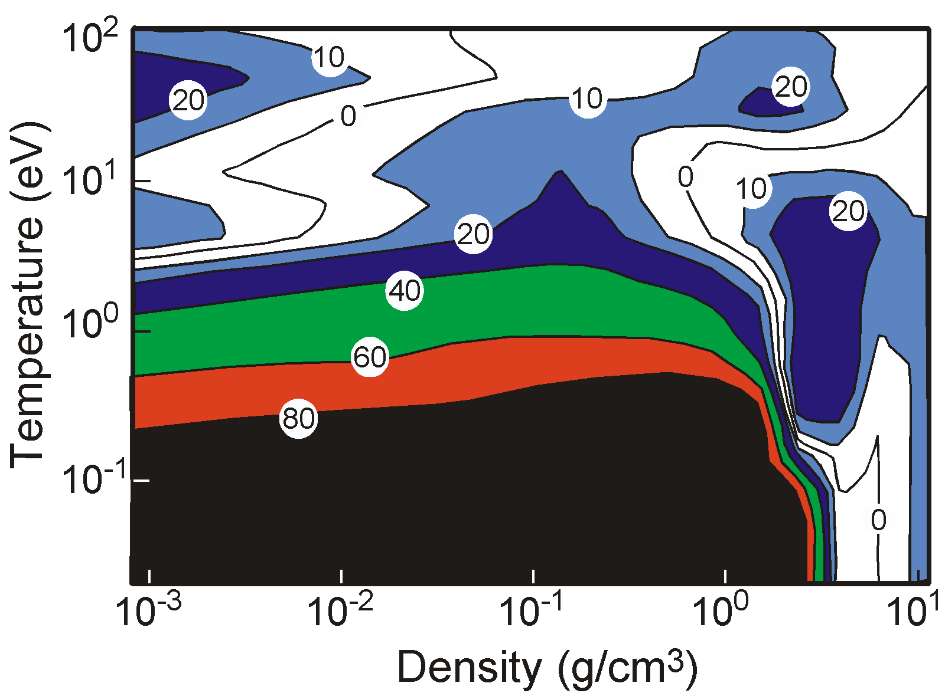
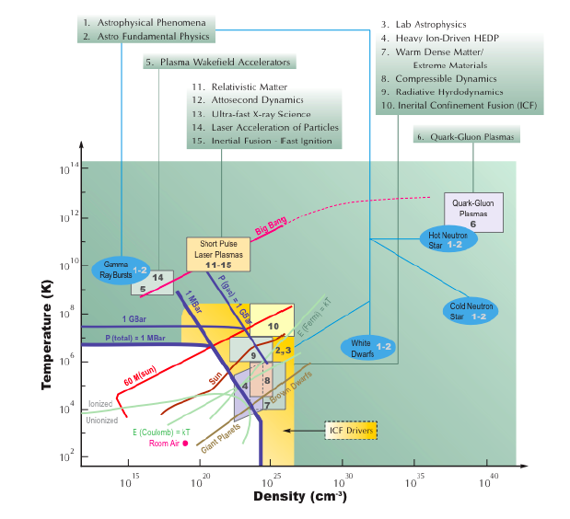
NDCX II covers WDM region -- a region of large uncertainty in EOS
10²⁰
10²¹
10²²
10²³
EOS pressure variance for 2 eqs. of state in Al
(R. Lee)
Density - Temperature
universe
10¹⁴
1000
10⁷
100
10⁶
HIF
eV
Temperature (K)
10
10⁵
NDCX II
10⁴
1
Heavy-ion-beam driven warm dense matter and fusion target interactions
NDCX I
solid Al
10³
0.1
10²
10²⁰
10²¹
10²²
10²³
10¹⁵
10⁴⁰
Ion density (cm⁻³)
From National HEDP Task Force Report, 2004.

